Slide 1
Terraform For Developers
Capco @ Apr 5, 2024

Slide 2
Let’s prepare first.. (Terraform)
Terraform
brew install terraform
terraform -v
Check completion (tabtab) works
Terraform-ls
brew install terraform-ls
terraform-ls -v
Check completion (tabtab) works
VS Code Extension
HashiCorp Terraform (Official)
Code: https://github.com/walls-sharing/terraform-developer

Slide 3
Let’s prepare first.. (GMail and GCloud)
Chrome Profile & Gmail
Create new Chrome profile (Top-right picture ➡️ Add)
Sign In ➡️ Create Account <your_name>.tfdev.1@gmail.com
Backup email (your personal email address)
Google Cloud
Use our new Chrome profile -> https://console.cloud.google.com
Top-right Activate ➡️ Thailand ➡️ Personal project ➡️ Continue
Individual Account ➡️ CC# ➡️ Start My Free Trial
** Do not activate full account **
Google Cloud SDK (gcloud-cli)
brew install --cask google-cloud-sdk
gcloud auth login

Slide 4
Fundamental Concepts

Slide 5
Infrastructure as Code (IaC)
“The process of managing and provisioning computer data center resources through machine-readable definition files, rather than physical hardware configuration or interactive configuration tools.”
Thank you Wikipedia!🎉

Slide 6
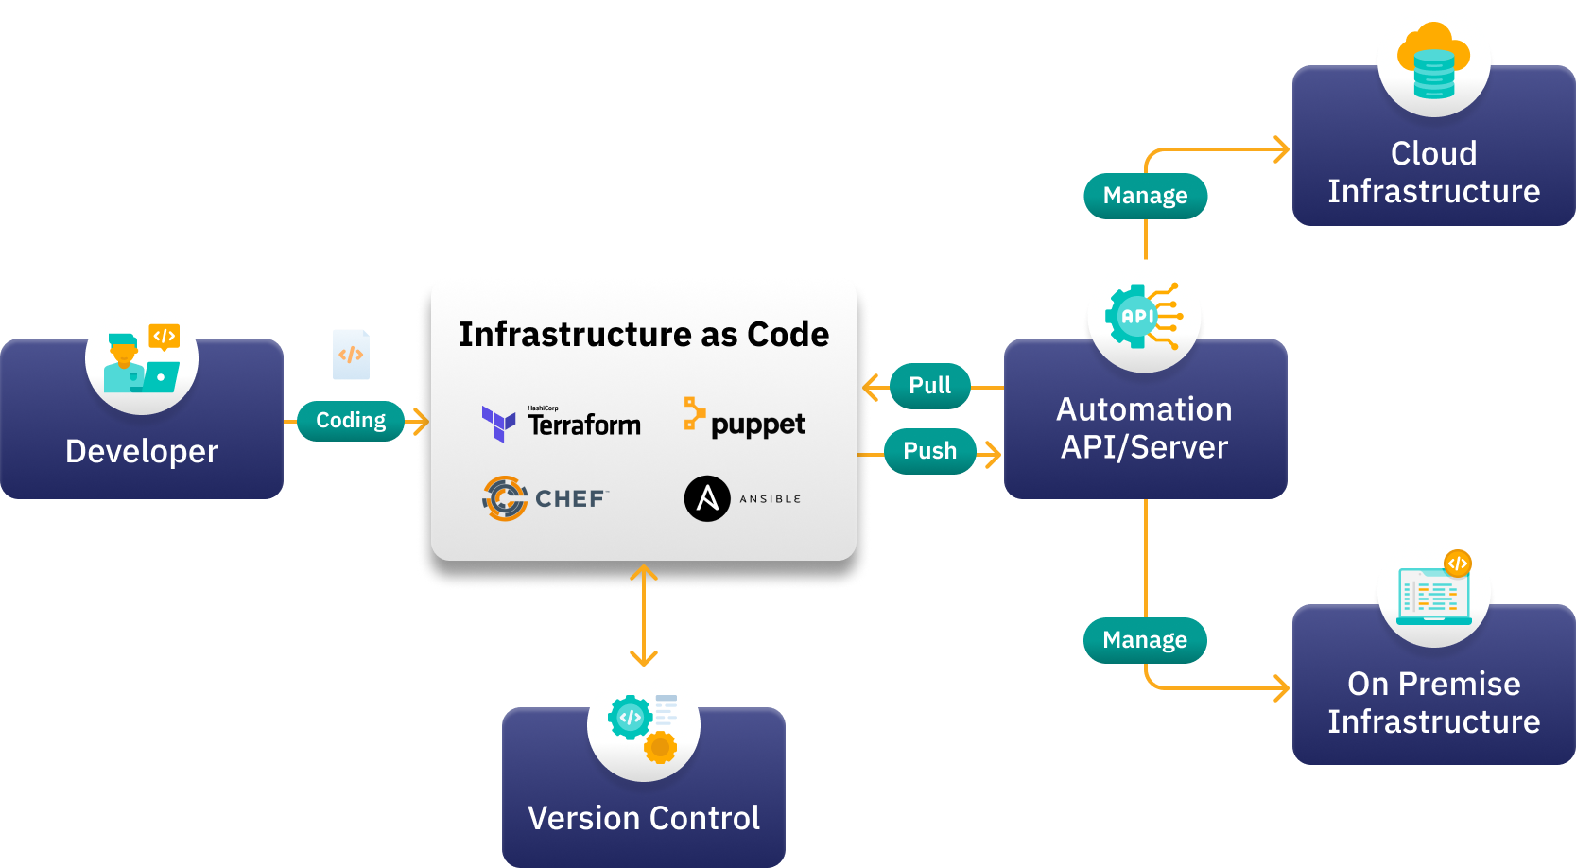


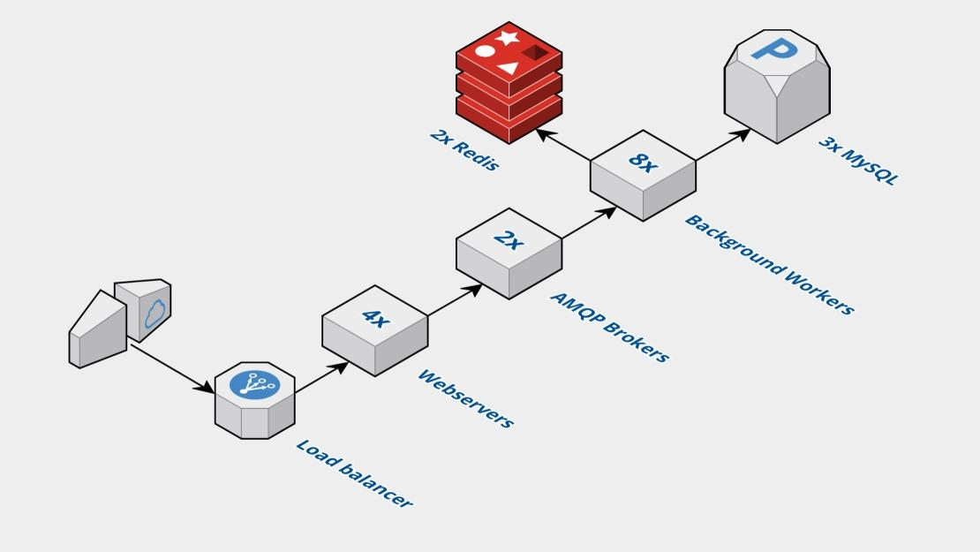
Then
Traditional ClickOps vs IaC

Slide 7
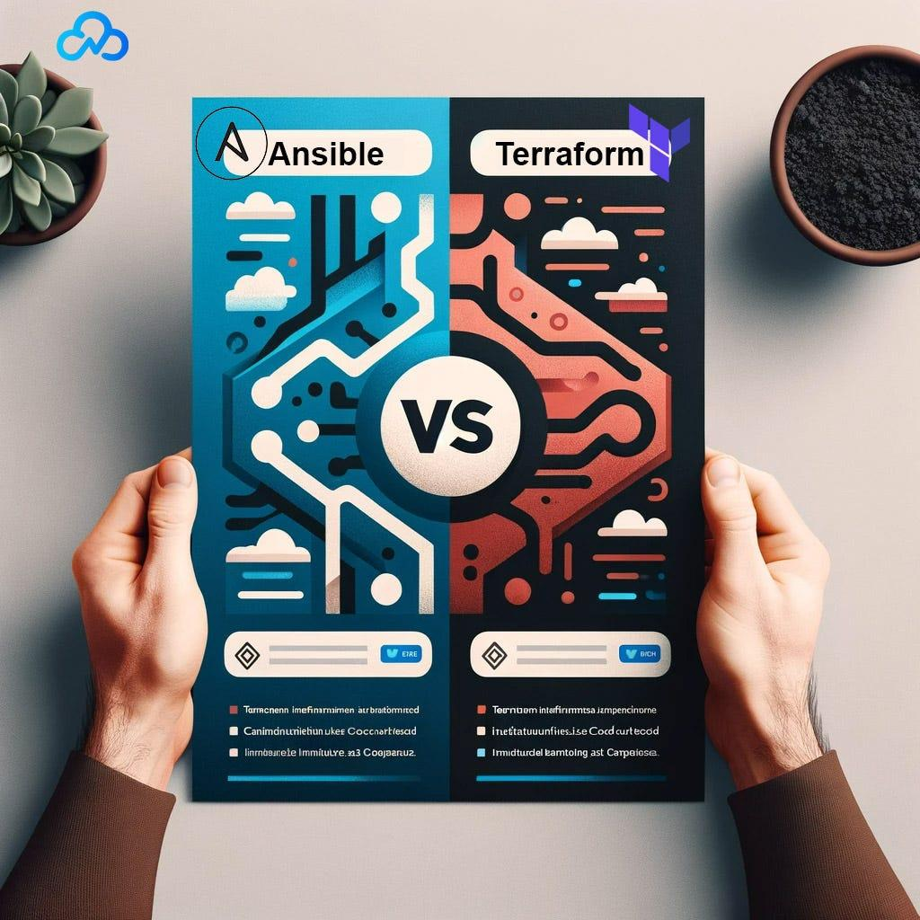
Orchestration (Provisioning) Tool
Create the infrastructure – virtual machines, network components, databases, etc.
E.g. Terraform, OpenTofu, Pulumi, AWS CloudFormation, Azure ARM Templates, Google Deployment Manager, etc..[click]
Initially created for Cloud, IaaS, PaaS, SaaS provisioning.
Configuration Management
Automating software installation, OS configuration tasks, network and firewall configuration, etc.
E.g. Ansible, Puppet, Chef, Saltstack, etc.
Initially created for server/hardware configuration.
Orchestration vs Configuration Management Tool
An excellent comparison article: [Click]

Slide 8
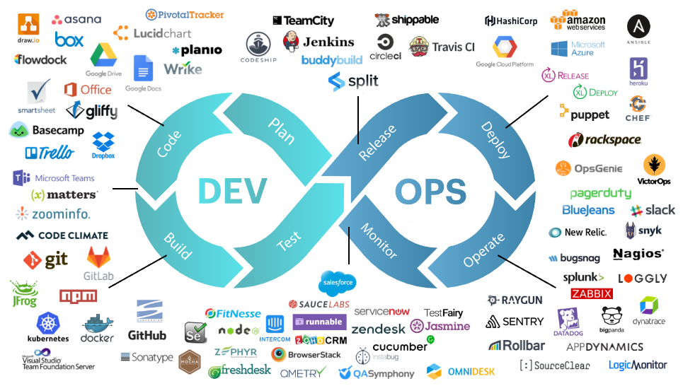

Slide 9
IaC Benefits and Challenges
👌 Automation
👌 Reviewable & Traceable
👌 Shift-left & Standardization
👌 Scalable (📑 ->📋optional!)
👌 Disaster Recovery
🤞 Learning Curve
🤞 SDLC Management
🤞 Code Complexity & Technical Debt
🤞 Separation of Responsibility

Slide 10
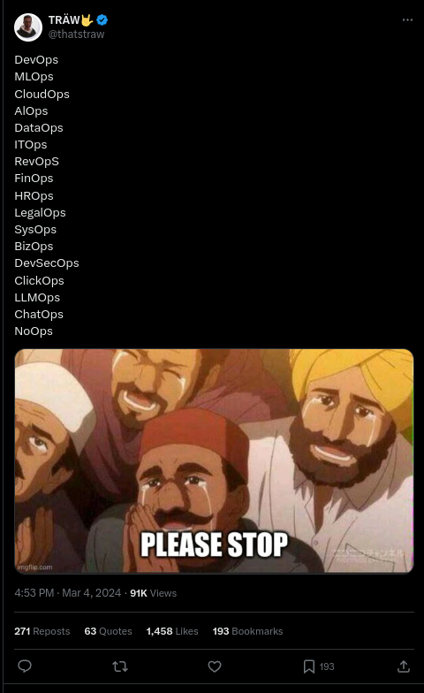

Slide 11
Hands-on!

Slide 12
Before we begin..
Verify Setup
✅ Applied Google Cloud free credit.
✅ terraform -v
✅ terraform-ls -v
✅ VS Code extension (HachiCorp Terraform)

Slide 13
HCL-01 Local Resource & Workflow

Slide 14
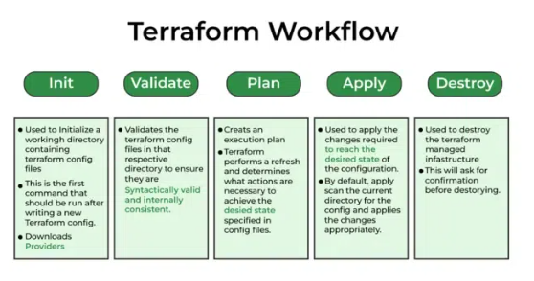
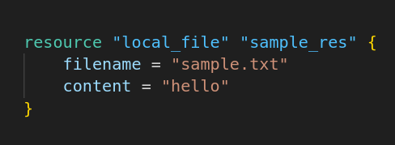
HCL-01: Resource
A resource block.. “Describes infrastructure object(s), such as virtual networks, compute instances, …”
Resource Type
Resource Name

Slide 15
HCL-01: Terraform Workflow
write
init
plan
apply
✍️
terraform init
terraform plan
terraform apply

Slide 16
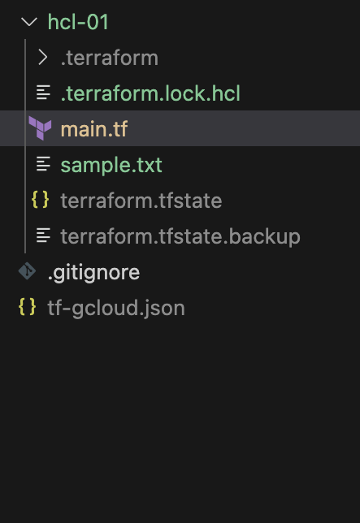
HCL-01: Dependency Lock & State
Dependency
Same as package management in your favourite language.
State
Store what is created or depended by resource.
Allow “Drift Detection” mechanism by design.
terraform show
State is locked during apply.
try terraform apply concurrently.
Terraform Remote State [Tutorial]
Terraform Cloud [Tutorial]
Dependency binary
Dependency lock file
State file
👻

Slide 17
HCL-02: Variable & Output
Variable
Output
Primitive
any, string, number, bool
List/Set/Tuple
List: list(string) = ["red", "green", "red"]
Set: a list deduplicated when evaluated.
Tuple: tuple([string, number, bool]) = ["a", 1, true]
Map/Object
Map: {a = 1, b = "red"}
Object: object({a = number, b = bool}) = {1, true}
See values when plan / apply.
terraform show
Send data between modules.
Sensitive variable value hidden.

Slide 18
HCL-03: Input
Input Sources [link]
Environment variables (e.g. TF_VAR_myvar=abc)
terraform.tfvars
*.auto.tfvars
*.tfvars <-- Need cmd input
Command Line
terraform plan|apply –var-file "my-var.tfvars"
terraform plan|apply –var "myvar=hello"
String Expression
”hello-${myvar}” [link]

Slide 19
Google Cloud !

Slide 20
Before we begin.. (Service Account)
Create Service Account
https://console.cloud.google.com/iam-admin/serviceaccounts
Click “Create Service Account”
Step1: Name: terraform ➡️ “Create and continue”
Step2: Role: Owner ➡️ “Continue”
Step3: (just click “Done”)
Download Service Account Key
Click “terraform@..........iam.gserviceaccount.com”
Click tab “KEYS” ➡️ click “ADD KEY” ➡️ “Create new key” ➡️ “JSON” ➡️ “Create”
Change file name to “tf-gcloud.json” ➡️ Save
Copy “tf-gcloud.json” to your practice directory

Slide 21
TG-01: GCP & Provider Versioning
Key Points
Terraform block
Terraform Registry:
https://registry.terraform.io
Version constraint
https://developer.hashicorp.com/terraform/language/expressions/version-constraints
terraform init -upgrade

Slide 22
TG-02: Google Cloud Storage (GCS)
Steps 🚶🪜👣
1️⃣ Config provider
2️⃣ Config bucket
3️⃣ Allow public access to bucket
4️⃣ Config objects (files)
5️⃣ Allow public access to objects

Slide 23
TG-02: Google Cloud Storage (GCS)
Key Points
Object storage, much like AWS S3
Meta-arguments [link]
Can be either non-block (count, for_each) or block.
Built-in function ( toset() ) [link]
for expression [link] (intermediate level)
Can see it like “map” or “filter” (higher-order function)
Can output as list or map.

Slide 24
TG-03: Google Cloud Run
Key Points
Google Cloud Run: Managed container service, comparable to AWS Fargate on ECS
Splat expression
google_cloud_run_service.hello_terraform.status.*.url
(GCP) Authoritative vs Non-Authoritative IAM management

Slide 25
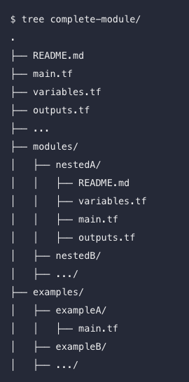
TG-04: Local Module
Key Points
Standard module structure
https://developer.hashicorp.com/terraform/language/modules/develop/structure
Use “Output” to communicate between modules.
You can just separate file for e.g. personal project !

